Slide 1
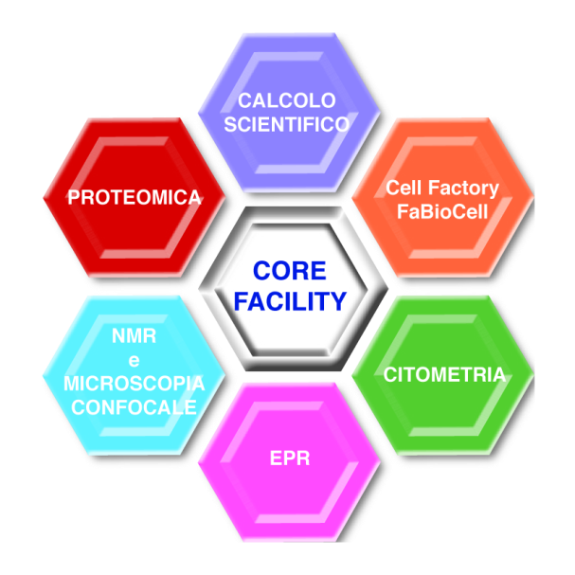
Spettrometria di Massa delle proteine:
dall’identificazione alla caratterizzazione
Area di PROTEOMICA
ISS 03/05/2017

Slide 2
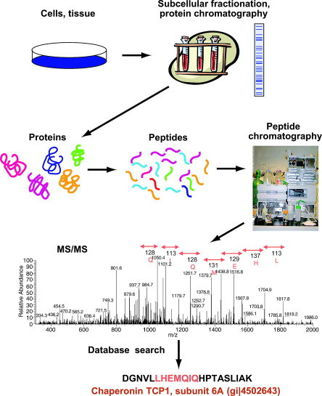
Sample
Mass Spec

Slide 3
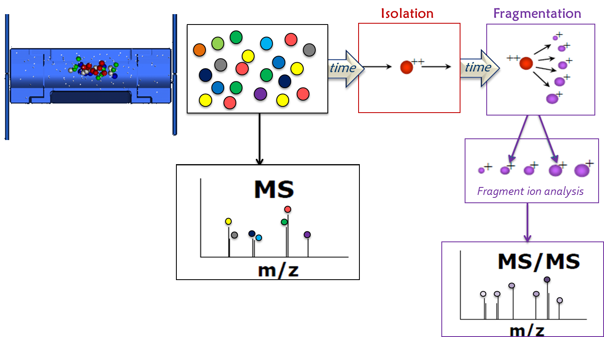
(CID,ETD)

Slide 4
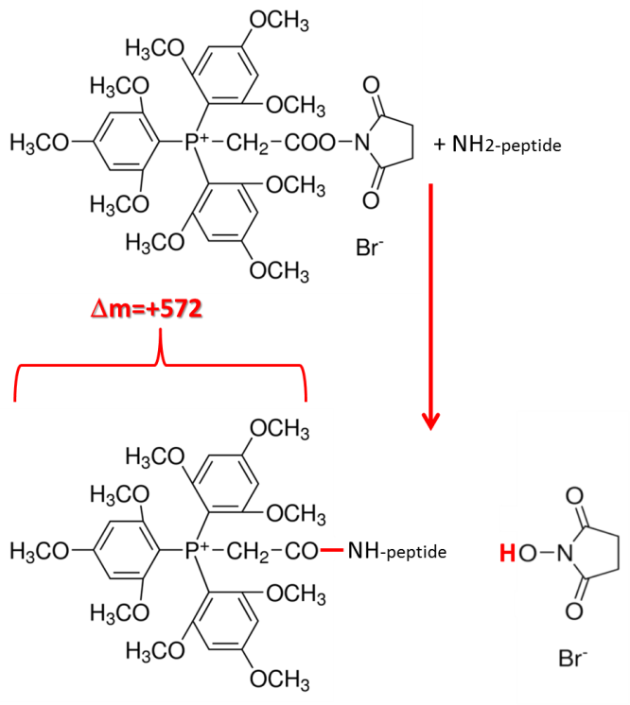
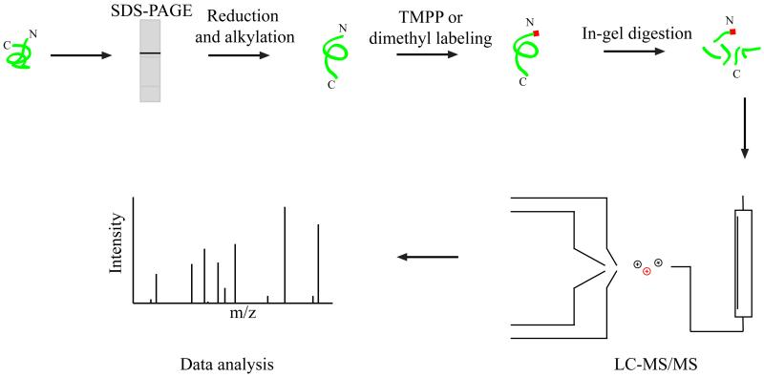
Protein Labelling
Per aumentare l’efficienza di ionizzazione dei peptidi e il sequence coverage
TMPP
Δm=+572
PTX3
…

Slide 5
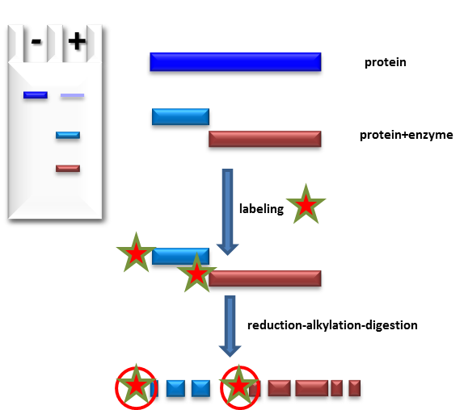
Per caratterizzare neo-Ntermini
Δm=+572
=TMPP
= anidride propionica/butirrica
Δm=+56/+70
Δm=+70
PTX3+uPA
Propionilazione / Butirrilazione

Slide 6
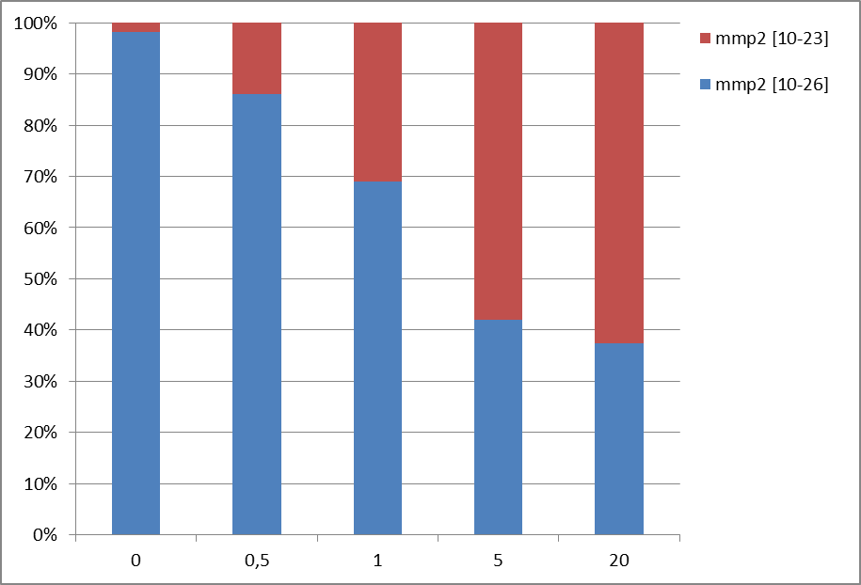
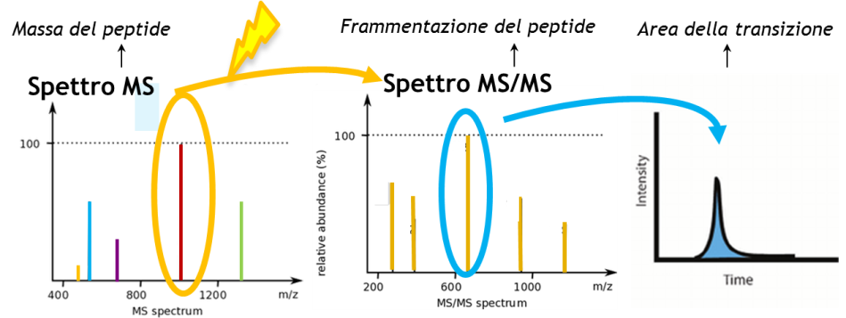
3. α-distroglicano
613
651
hours
hours

Slide 7
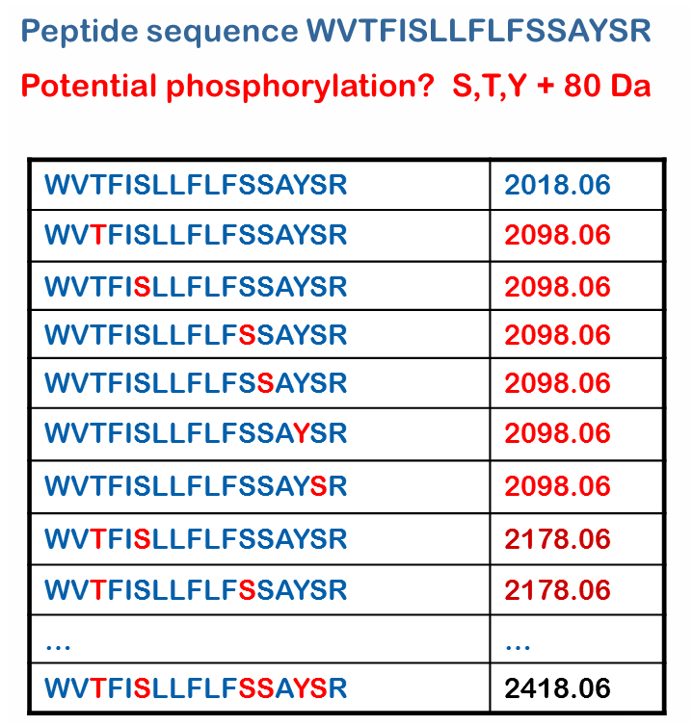
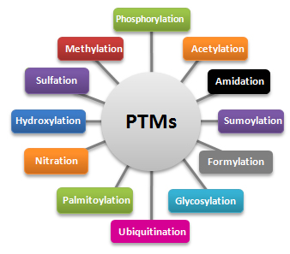
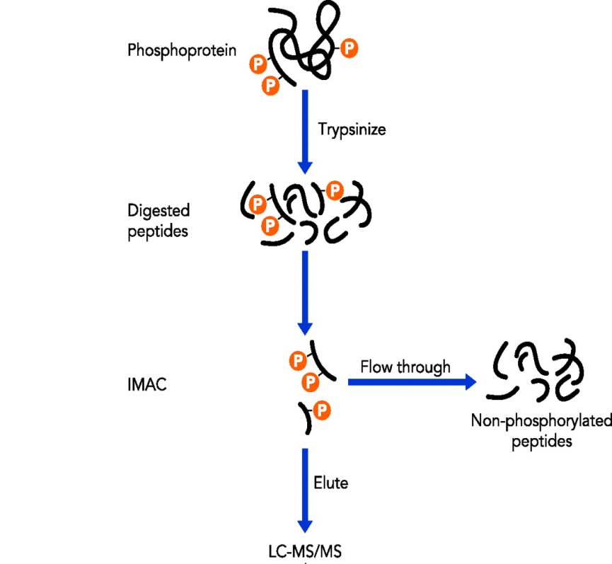
Modifiche post-traduzionali
Fosforilazione
TiO₂ enrichment

Slide 8
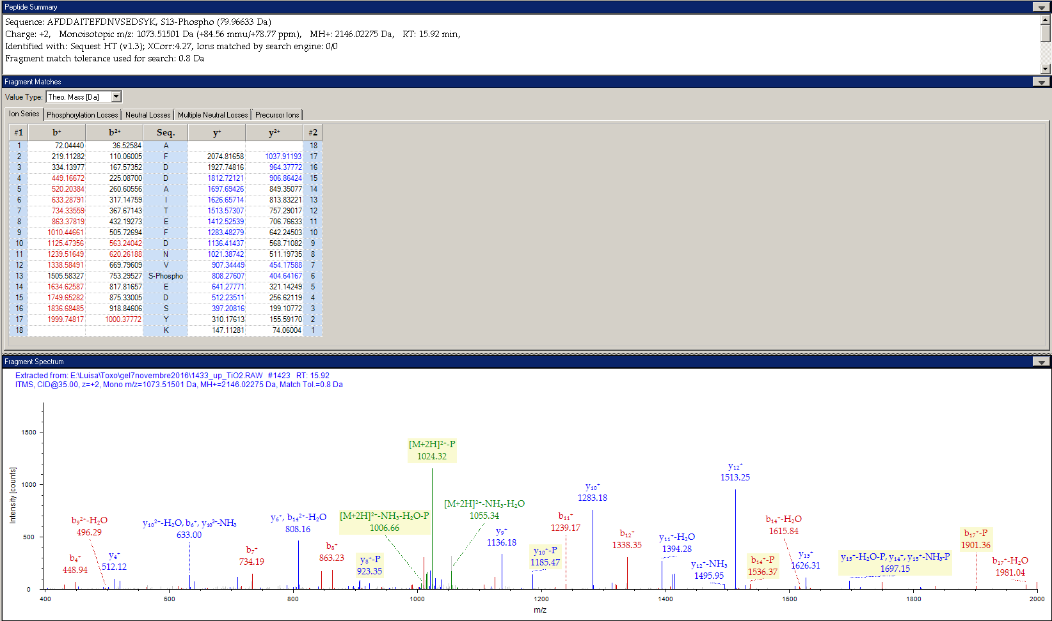
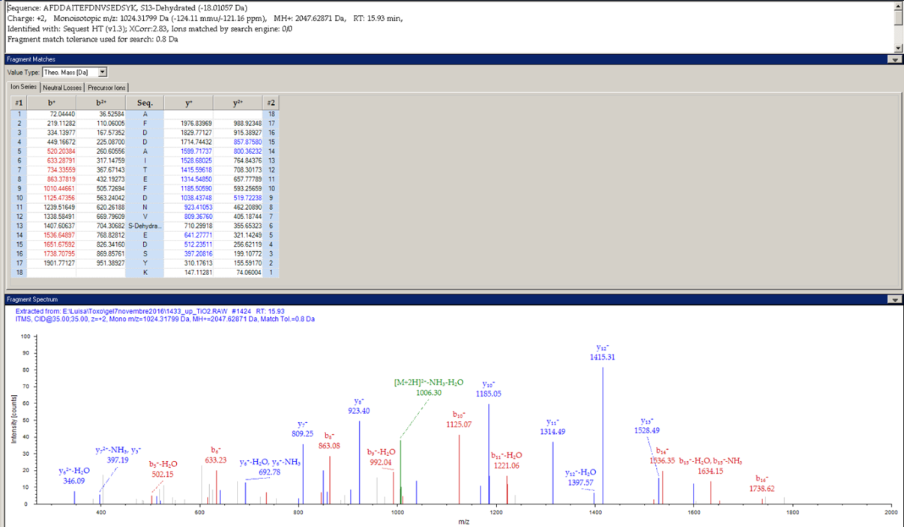
Toxoplasma→ 14-3-3 protein
AFDDAITEFDNVSEDSYK
MH⁺= 2146,02
^{Z=2 1073,52 Da}
MS²
[M-2H]⁺-P
P = - H₃PO₄
MS³

Slide 9
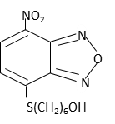
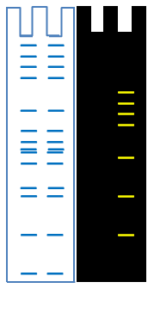
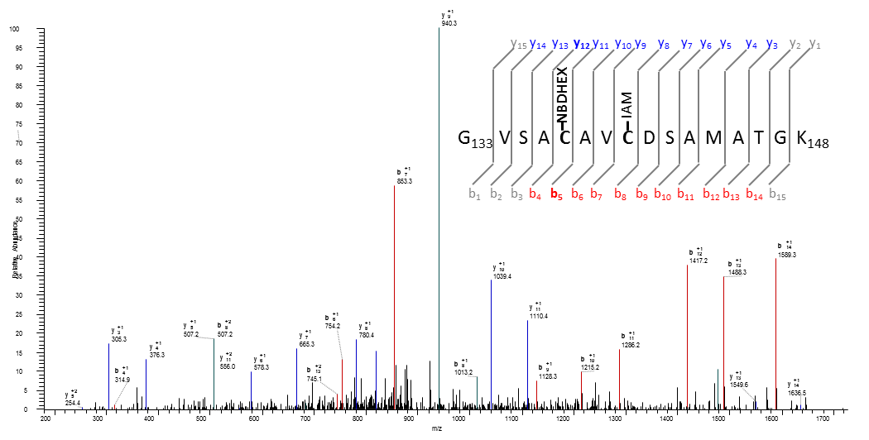
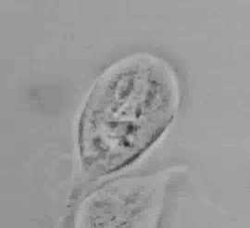
Addotti
1. Addotti farmaco-proteina
NBDHEX
Incubation with parasite
UV
TrxR
Isolation of fluorescent protein bands
LC-MS/MS
Lalle M.et al .The FAD-dependent glycerol-3-phosphate dehydrogenase of Giardia duodenalis: an unconventional enzyme that interacts with the g14-3-3 and it is a target of the antitumoral compound NBDHEX. Front Microbiol. 2015
Camerini S., et al Proteomic and functional analyses reveal pleiotropic action of the anti-tumoral compound NBDHEX in Giardia duodenalis. Int J Parasitol Drugs Drug Resist. 2017.

Slide 10
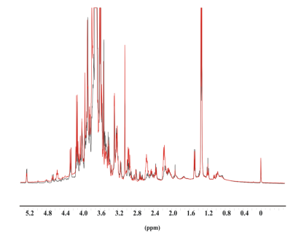
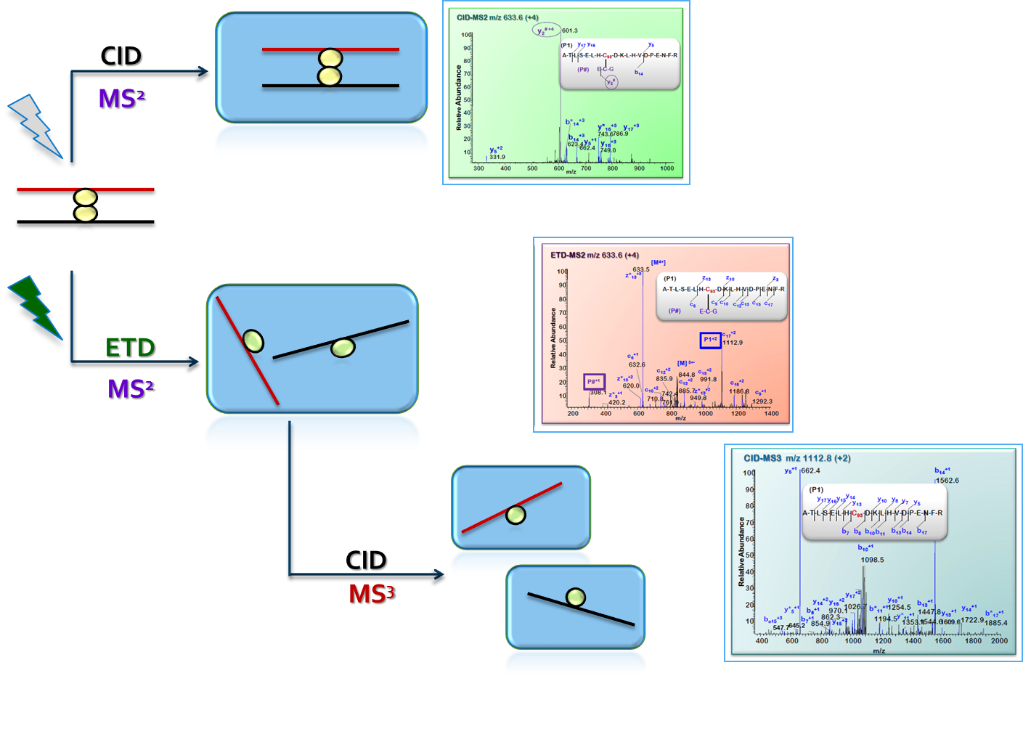
2. Addotti peptide-proteina
Hb - glutathionylation
MS approach:
Lac
tCr
Glx
GSH
GSH
Ala
Metere A, et al. Carbon monoxide signaling in human red blood cells: evidence for pentose phosphate pathway activation and protein deglutathionylation. Antioxid Redox Signal. 2014

Slide 11
Interattoma
Yamamoto et al.The nebulin SH3 domain is dispensable for normal skeletal muscle structure but is required for effective active load bearing in mouse. J Cell Sci. 2013

Slide 12
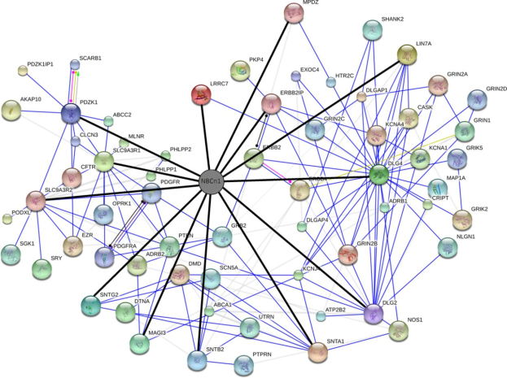
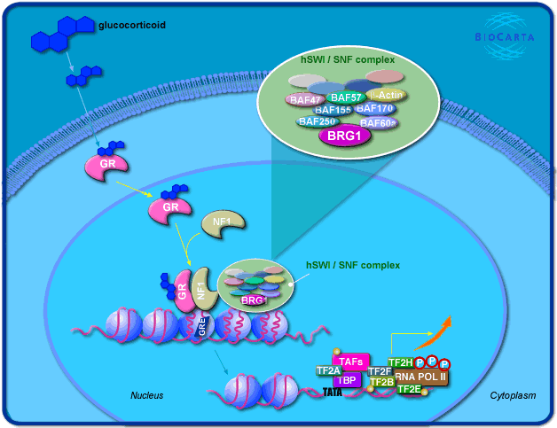

Slide 13
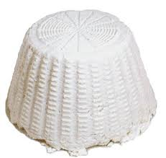
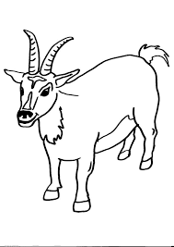
Analisi Quantitativa
MS
MS/MS
intensity
Camerini Casella et al. Mass spectrometry detection of fraudulent use of cow whey in water buffalo, sheep, or goat Italian ricotta cheese.
Food Chem. 2016
time

